Slide 1
ELECTRONIC COMPONENTS

Slide 2
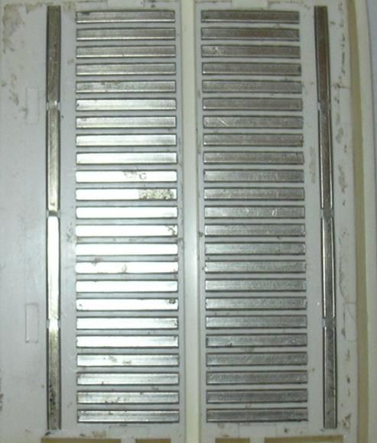
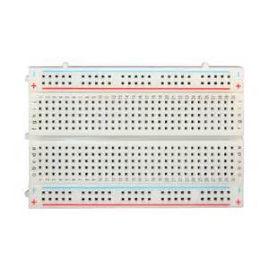
Bread Board
Internal connections

Slide 3
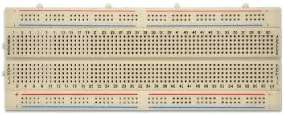
Testing Circuits
Shorted

Slide 4
Integrated circuits - ICs
It is a set of electronic circuits made on a single plate of semiconductor material (chip), usually silicon.
This can be made much smaller than a discrete circuit made from independent components.
ICs can be made very compact, having up to several billion transistors and other electronic components in an area the size of a fingernail.
Eg.
1. Motor Driver : L293D
2. Voltage regulator : 78XX

Slide 5
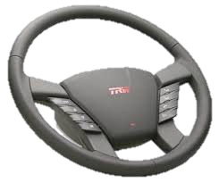
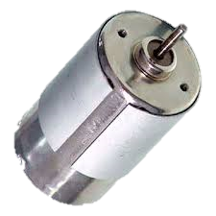
Motor Drivers

Slide 6
Motor Drivers
Motor Drivers are integrated circuits that govern the performance of an electric motor.
They can control the speed, torque and direction of motors as well as synchronise their motion.
Eg. L293D

Slide 7
Need of Motor Drivers
The current requirement of typical DC Motors is ~500 mA but the microcontrollers that we use can provide current of order of 5mA.
Hence motors cannot be directly controlled by microcontrollers and so an interface is required between MCU and Motors.
Motor Driver acts as the interface as it accepts small current, amplifies it and supplies large current to motor.

Slide 8
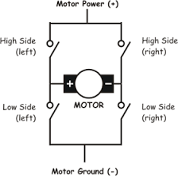
H - Bridge
Schematic Diagram
An H-Bridge allows us to easily change the direction of applied voltage across a load.
It can be used to control the motor shaft’s direction of rotation, apart from acting as a switch.
H-Bridge contains 4 switches arranged in such a fashion that polarity of motor can easily be reversed.

Slide 9
Result of closing any 2 switches
Switches closed | Action
Left high and Right low | Anticlockwise rotation
Right high and Left low | Clockwise rotation
Right high and Right low | Motor brakes
Left high and Left low | Motor brakes

Slide 10

Schematic diagram of H-bridge.

Slide 11
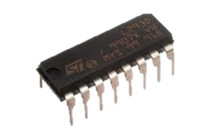
Motor Driver : L293D
L293D IC generally comes as a standard 16-pin DIP (dual-in line package). This motor driver IC can simultaneously control two small motors in either direction; forward and reverse with just 4 microcontroller pins.

Slide 12
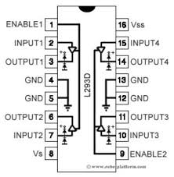
Schematic diagram of L293D

Slide 13
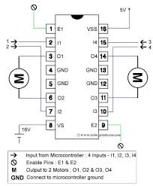
Connections for L293D

Slide 14
Features of L293D
L293D has an enable facility which helps you enable the IC output pins. If an enable pin is set to logic HIGH, then state of the inputs match the state of the outputs. If you pull this low, then the outputs will be turned off regardless of the input states.
It has an “Over Temperature Protection" built into the IC. This means an internal sensor senses its internal temperature and stops driving the motors if the temperature crosses a set point.

Slide 15
… Continued.
It’s internal clamp diodes help protect the driver IC from voltage spikes that occur when the motor coil is turned on and off (mostly when turned off).
The logical low in the IC is set to 1.5V. This means the pin is set high only if the voltage across the pin crosses 1.5V which makes it suitable for use in high frequency applications like switching applications (up to 5KHz)

Slide 16
Specifications
Supply Voltage : 5V (regulated)
Maximum output current : 600mA (per channel), 1.2A (peak for both)
Maximum supply voltage : 36V

Slide 17
Sensors
A Sensor is a device that detects events or changes in physical quantities and provides a corresponding output, generally as an electrical or optical signal.
A sensor's sensitivity indicates how much the sensor's output changes when the input quantity being measured changes.
Eg.
Digital Thermometer
IR Sensor

Slide 18
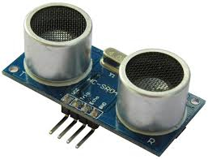
Ultrasonic Sensors
It is used to measure the distance, from the sensor, to any obstacle / surface if it is within its range
It has a transmitter, a receiver and a control circuit on it .
It uses sound waves : it sends sound waves and then capture the reflected waves, to estimate the distance.

Slide 19
Specifications
It has 4 pins.
Working Voltage: DC 5V.
Working Current: 15mA.
Working Frequency: 40 KHz.
Range : 2cm to 3m.
Measuring Angle: 15 degree

Slide 20
Pins
The pins : VCC and GND are for powering the chip.
The TRIG pin takes input signals from your Arduino.
The ECHO pin gives the output to your Arduino.

Slide 21
Working
To start, Trig pin must receive a pulse of high (5V) for at least 10µs, this will initiate the sensor and will transmit out 8 cycles of ultrasonic burst at 40kHz . The echo pin is set to HIGH (5V) at this time.
After it gets reflected (if it does at all) when it hits the receiver (here, it waits for the 8th cycle to return), the ECHO pin is set to LOW (GND) and then delayed for a time (width of the pulse) proportional to the distance.
So, effectively it is giving the time taken by the signal to go hit an object and come back.

Slide 22
Interfacing with an Arduino
To work with the ultrasound sensor, we connect the Vcc of the sensor to the 5V supply, the GND to the GND line, the TRIG pin to a digital output pin on the arduino, and the ECHO pin to a digital input pin
Set the trig pin on high, det a delay of 5, wait for for the pulse to return, measure the pulse width to return, measure the pulsewidth given by the echo pin.
This gives you the time taken by the pulse to travel from the sensor, hit an obstacle, and retun (in milliseconds).
Knowing this, and the speed of sound in air (approximately 334m/s) we can calculate the distance between the obstacle and the sensor.

